Slide 1
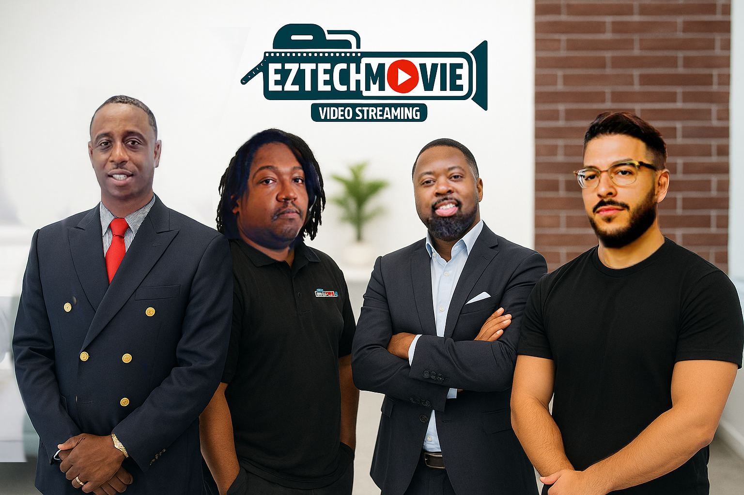

INT499: Information Technology Capstone Travis Simmons, Chad Grismore, Christopher Carson, Victor Ledezma Professor John Russell 06/10/2025
Travis Chad Chris Victor
EZTechMovie Presentation

Slide 2


About EZTechMovie
EZTechMovie is a privately owned video streaming company based in San Diego, California. At present, the company generates an annual revenue of $1.5 million. However, it is poised for significant growth, with projections indicating an increase to $15 million in annual revenue over the next three years. This ambitious expansion plan aims to boost the number of active users from 1 million to an impressive 10 million, reflecting the company's commitment to enhancing its market presence and delivering quality content to a broader audience.

Slide 3
Mission Statement
EZTechMovie's mission is to become the premier destination for high-quality movie streaming in the nation while actively pursuing global licensing agreements to offer a diverse and captivating selection of content. We are dedicated to delivering an exceptional viewing experience that connects audiences with the films they love, fostering a vibrant community of movie enthusiasts.

Slide 4
Functional Requirements
The EzTechMovie application will operate as a monthly subscription-based service designed to provide users with a seamless movie discovery experience across multiple streaming platforms.
Users will have the flexibility to either stream movies directly within the app or be redirected to external platforms for viewing.
Compatibility will extend to modern desktop browsers, including Chrome, Firefox, Safari, and Edge.
EZTech will also be optimized for smart TVs, including Roku, Fire TV, and Apple TV, allowing users to enjoy content on larger screens.
The app will support iOS 14+ and Android 10+ operating systems as well as MacOS, Windows OS and Linux platforms.
User data protection will be prioritized, employing encryption during login and payment processing to safeguard personal information.
The application will leverage artificial intelligence to offer personalized movie recommendations, enhancing user engagement and satisfaction.

Slide 5
Target Audience
Casual Viewers: Individuals who enjoy occasional movie watching but prefer a budget-friendly option. The Basic Subscription appeals to this demographic, offering a limited selection of films without a significant financial commitment.
Families and Groups: Households looking for entertainment options that cater to multiple family members. Plans that allow simultaneous streaming make EZTechMovie an attractive choice for families seeking diverse content suitable for all ages.
Social Media Users: Young adults and social media enthusiasts who enjoy sharing their viewing experiences and engaging with friends. The Social Media Subscription allows them to connect with peers and share recommendations, enhancing their social interactions around movie watching.
Administrators: Individuals responsible for managing the platform’s operations, including content curation, user experience, and customer support. They are focused on ensuring that the service meets user needs and operates smoothly, making their insights vital for continuous improvement.
Stakeholders: Investors, partners, and content creators who have a vested interest in the platform's success. They are concerned with the overall growth, profitability, and sustainability of EZTechMovie. Engaging this audience is essential for securing funding, partnerships, and high-quality content that attracts users.

Slide 6
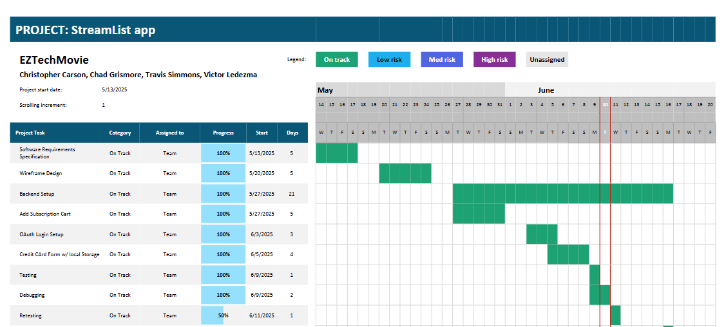
Gantt Chart

Slide 7
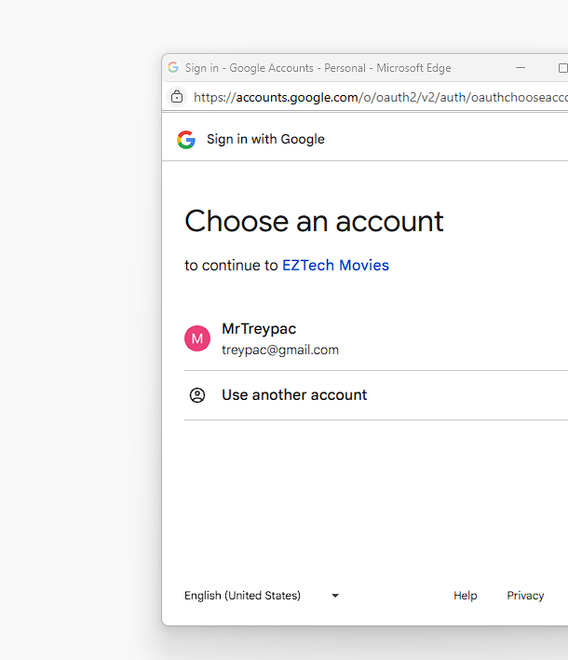
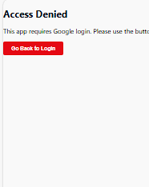
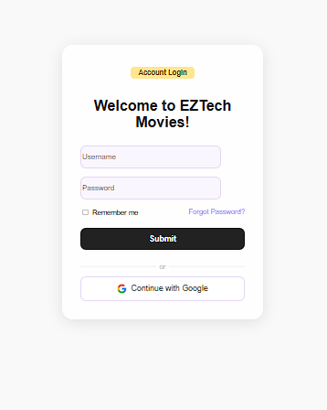
OAuth Login Integration
FamilyID=Office_ArchiveTorn

Slide 8
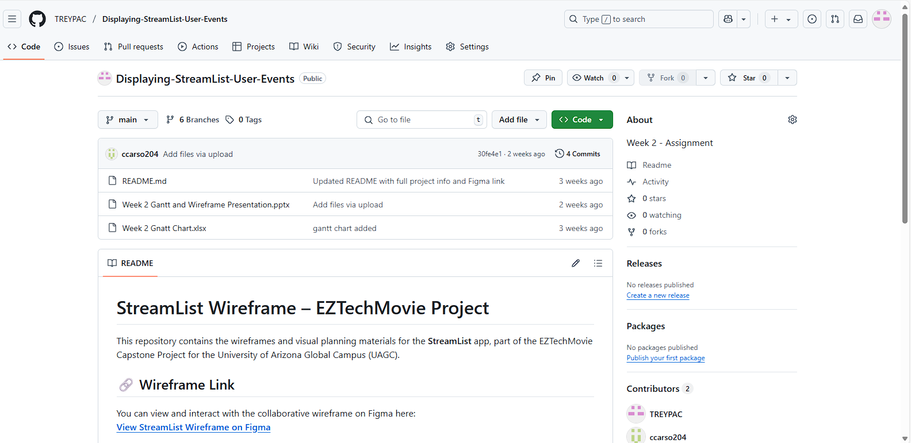
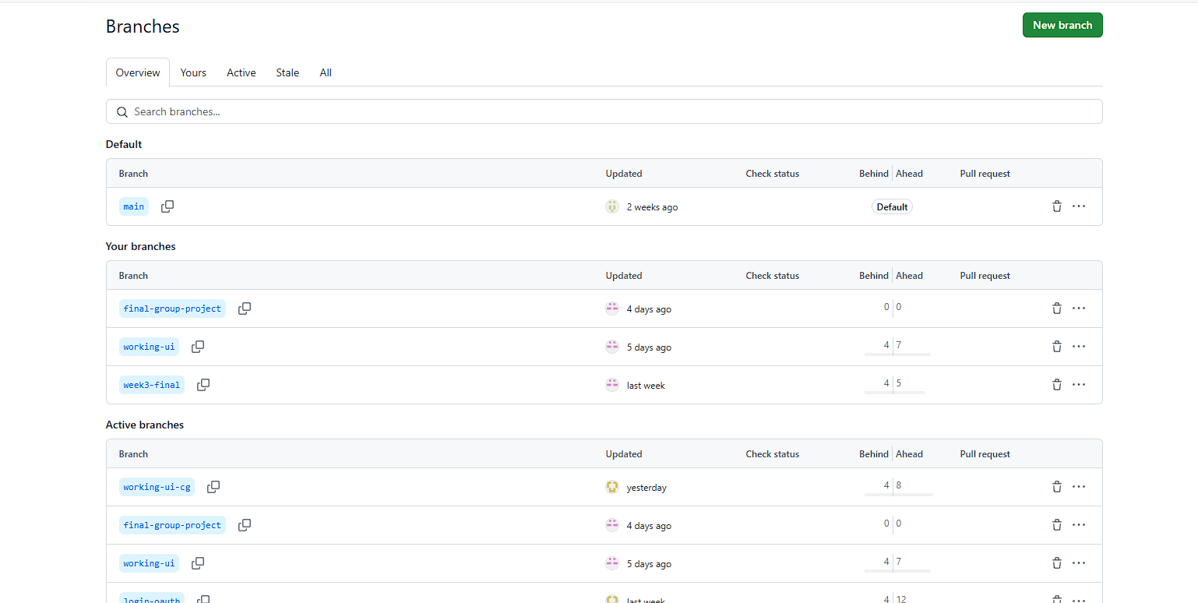
Github Repo and Deployment Summary

Slide 9
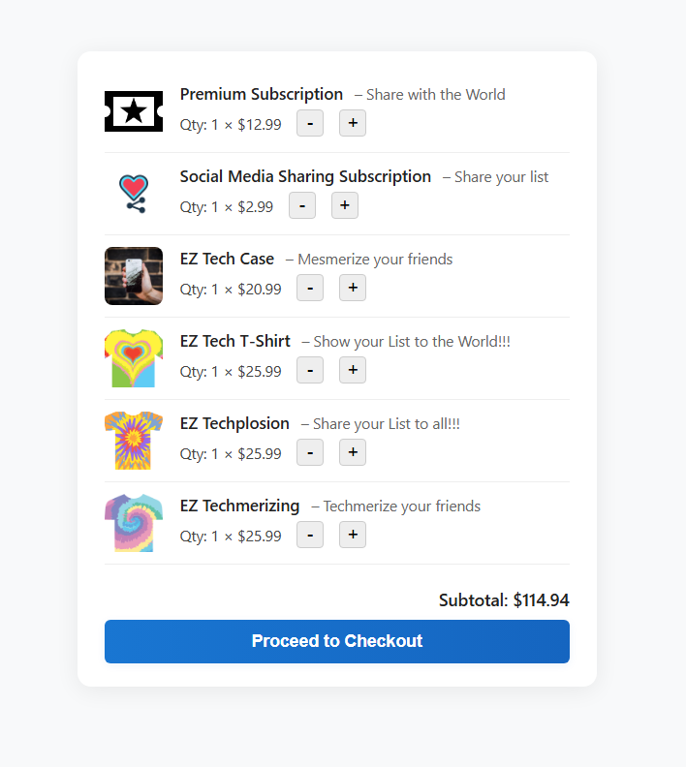


Cart Functionality
We implemented functions like addToCart (to increase the quantity or add a new item) and subtractFromCart (to decrease the quantity or remove an item if it reaches zero).
I also ensure the cart displays all items correctly, updates totals, and responds to user actions in real time.

Slide 10
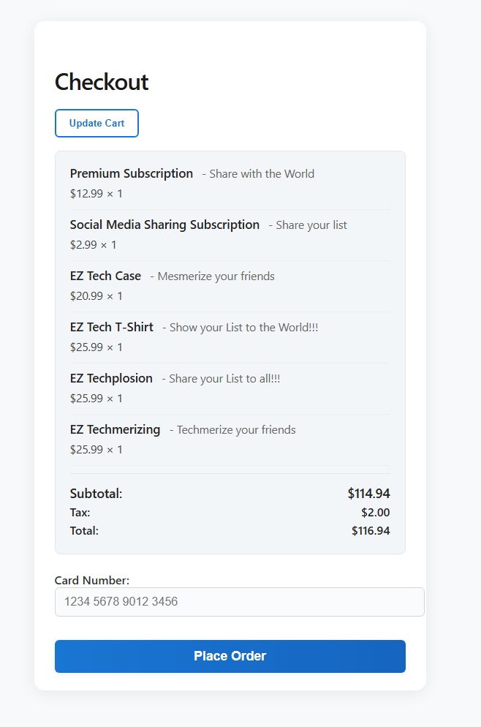
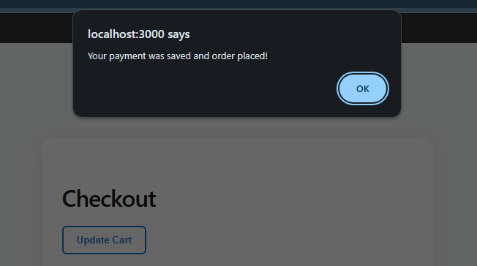
Checkout and Credit Card Flow
The checkout page pulls the latest cart data, shows an order summary, and provides a form for entering a credit card number.
Handles validation (making sure the card number is in the right format) and processes the order, such as clearing the cart and saving the card info when the order is placed.

Slide 11
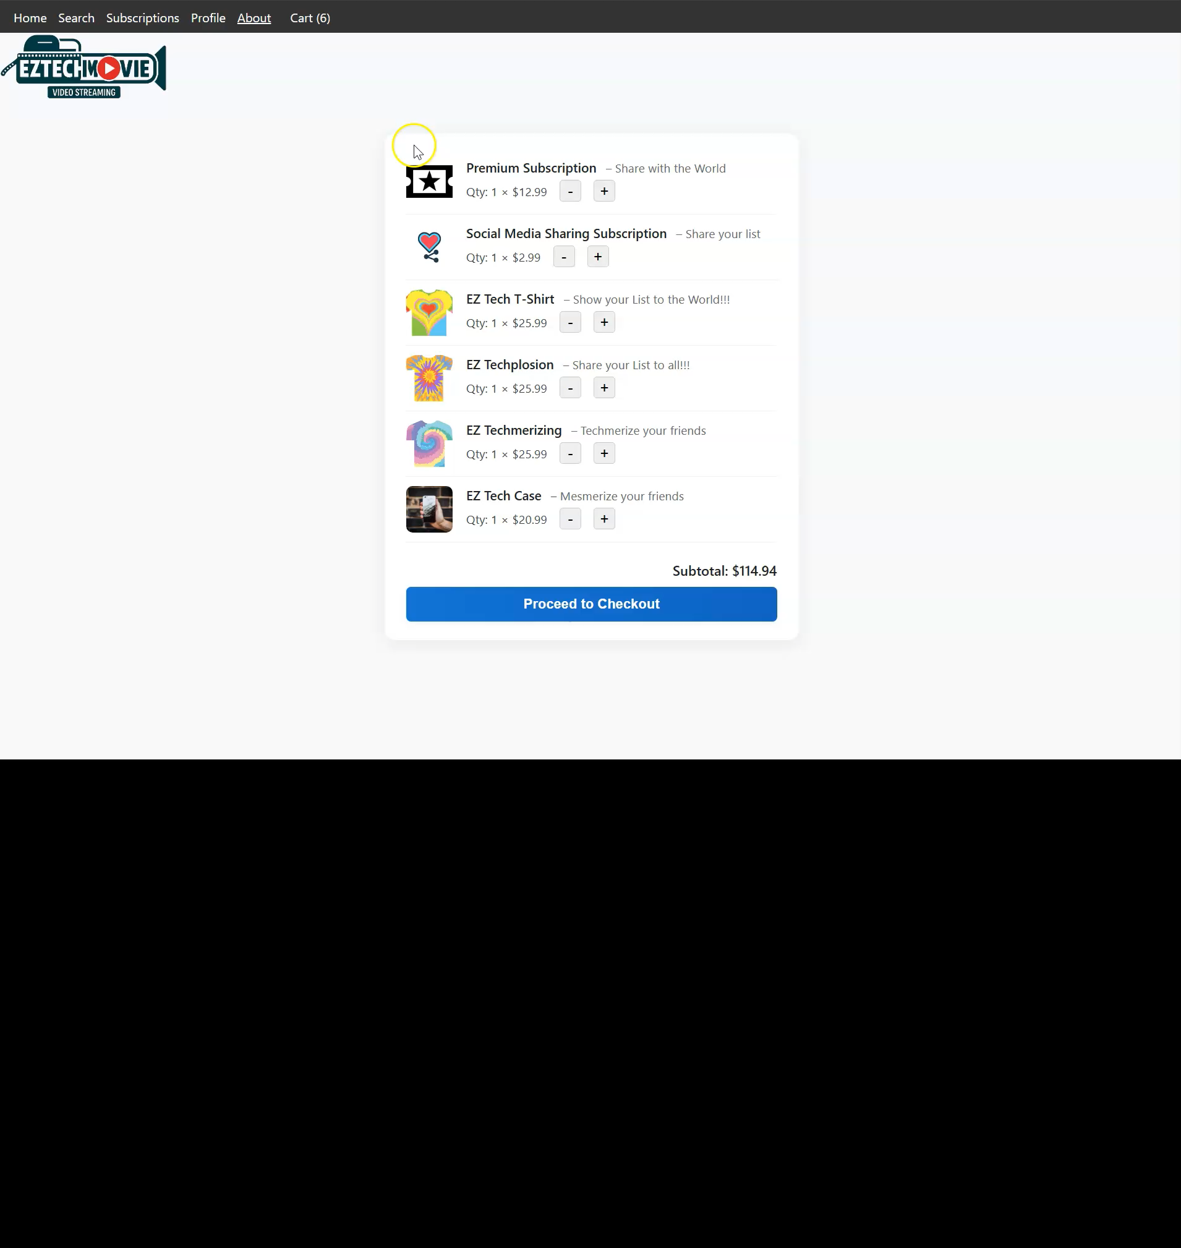
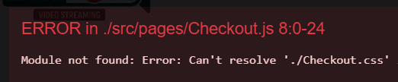
Bugs or Difficulties Encountered
A development challenge we had was setting up the dummy credit card system without actually having all the information needed to make a live system.
The second would be making sure code quality is in place. The linking of classnames and importing can be very confusing, especially when pulling from multiple different files in different folders. A simple (../) can crash your program.

Slide 12

Security Paper
The Payment Card Industry Data Security Standard (PCI DSS): is a comprehensive framework of security standards established to enhance the security of credit card transactions and protect sensitive cardholder information.
Data Breach - any incident where sensitive or confidential information is accessed, stolen, or disclosed to unauthorized individuals or entities.
Encryption - transforms readable data into an encoded format that can only be decrypted by authorized users.
AES (Advanced Encryption Standard) - is a widely adopted symmetric encryption algorithm that encrypts data in fixed-size blocks of 128 bits using keys of 128, 192, or 256 bits.
Tokenization - is the process of substituting a sensitive data element with a non-sensitive equivalent, referred to as a token.

Slide 13
SRS Highlights
Functional Requirements
User Registration
Secure Login
Watch List
AI-based Movie Recommendations
External Interface Requirements
Compatibility with smartphones/tablets, computers, and TVs
Internet requirements - 5 Mbps for SD, 10 Mbps for HD, and 25 Mbps for 4K streaming
Non-Functional Requirements
Capacity – able to support up to 100,000 active users with 10TB storage for user data.
Scalability – the platform is built around Microsoft Azure APP Service to allow scalability for future growth

Slide 14
Database Choice and Why
Azure Cosmos DB
Versatility
This database allows for a wide range of uses such as gaming, IOT, and social media apps making it perfect for our streaming application.
High Performance and Low Latency
It is capable of fast read and write speeds, in our case, we need to be able to pull and store data quickly.
Multi-Region Storage
Ability to store data in multiple regions giving us redundancy for a possible 99.999% SLA availability.

Slide 15
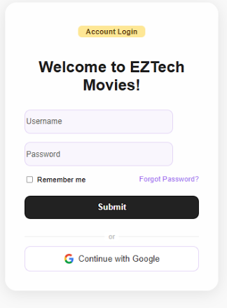

UI/UX Wireframes/Application Design
Upon launching the application, users are presented with a login screen where they can enter their user ID and password.
New users have the option to register for an account using their google accounts. After registration, users can log in using their credentials.
The system verifies the provided information against the database, and if it matches, users proceed to the next step.
Notes:
Hello everyone! Today, I’ll be walking you through the initial steps of using the EZTechMovie application, focusing on the login and registration process.
When users first launch the EZTechMovie application, they are greeted with a login screen.
This is the gateway to accessing all the exciting content the platform has to offer.
On the login screen, users are required to enter their user ID and password.
This step is crucial for ensuring that each user’s account remains secure and personalized.
For those who are new to EZTechMovie, there’s a convenient option to register for an account.
New users can easily sign up using their Google accounts, which streamlines the registration process and makes it user-friendly.
Once registration is complete, users can log in using their newly created credentials.
This allows them to access their personalized viewing experience right away.
After entering their login information, the system performs a verification process.
It checks the provided user ID and password against the database to ensure accuracy.
If the information matches, users are granted access to the next step of the application.

Slide 16
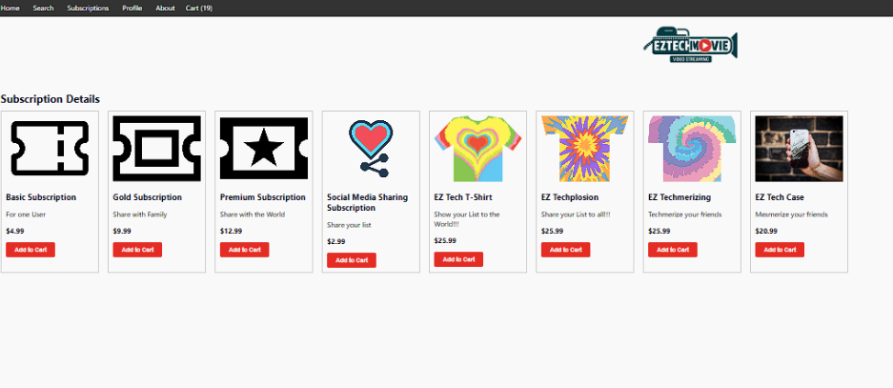
UX/UI Web Design
EZTechMovie offers users a variety of subscription options to cater to different viewing preferences and needs. When users log into their accounts and navigate to the subscription selection step, they can choose from the following plans as well as EZTech Merchandise.
Notes:
Next, I’ll be discussing the various subscription plans offered by EZTechMovie, each designed to cater to different viewing preferences and lifestyles.
Let’s start with the Basic Subscription.
This is the entry-level plan, perfect for casual viewers.
It provides access to a limited selection of movies, making it ideal for those who want to enjoy a few films without a significant commitment.
This plan is great for individuals who may not watch movies frequently but still want to have some options available.
Next, we have the Gold Subscription.
This mid-tier plan offers a broader range of movies and additional features compared to the Basic plan.
Users who opt for the Gold Subscription can enjoy more content and enhanced viewing options.
It’s particularly suitable for regular movie watchers who want a richer experience without going for the highest tier.
Now, let’s talk about the Premium Subscription.
This plan provides the most extensive access to the entire library of movies, including exclusive content and early releases.
It’s designed for avid movie enthusiasts who want the best viewing experience and the widest selection of films.
If you’re someone who loves to stay updated with the latest releases and exclusive titles, this is the plan for you!
Finally, we have the Social Media Subscription.
This unique plan allows users to connect with friends and share their movie experiences on social media platforms.
It may include features such as collaborative viewing or sharing recommendations, which is appealing to users who enjoy engaging with their social circles while watching movies.
This plan adds a social dimension to the viewing experience, making it more interactive and fun. EZTech has also launched an apparel line so our members can proudly represent our brand!

Slide 17
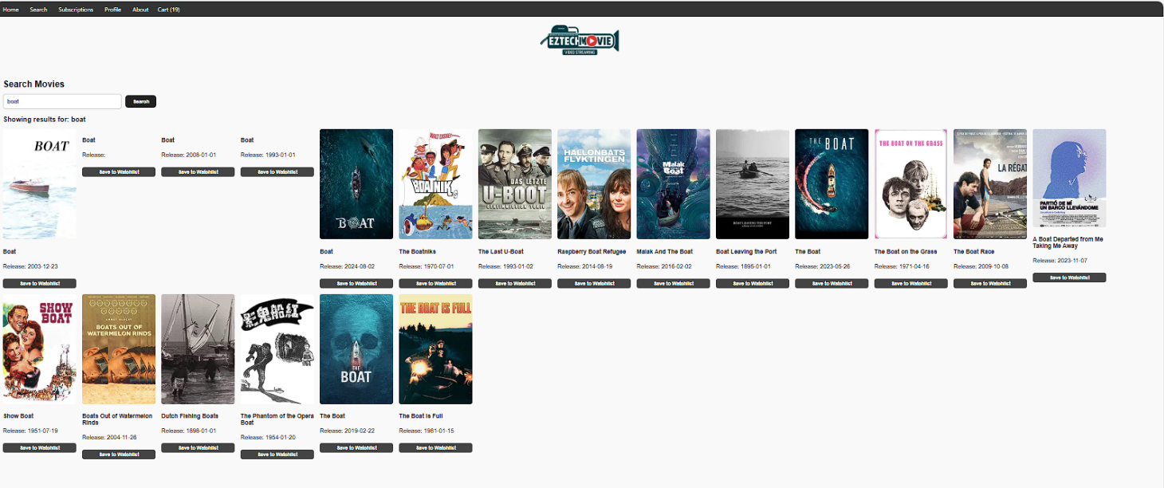
EZTech Preferred Filters
In the following step, users select their desired subscription plan and payment method. After choosing their experience plan, they are presented with a curated list of movies tailored to their preferences.
While users can only watch one movie at a time, they have the flexibility to stream on multiple devices simultaneously, depending on their selected plan.
Notes:
Now that we’ve covered the various subscription plans, let’s discuss the next steps users will take after selecting their plan on EZTechMovie.
After logging in, users will proceed to select their desired subscription plan.
This is an important step, as it determines the content and features available to them.
Along with the subscription plan, users will also choose their preferred payment method, ensuring a smooth transaction process.
Once users have made their selections, they will be presented with a curated list of movies.
This list is tailored to their preferences, making it easier for them to find films that align with their interests.
This personalized approach enhances the viewing experience, as users can quickly discover new content that they are likely to enjoy.
It’s important to note that while users can only watch one movie at a time, they have the flexibility to stream on multiple devices simultaneously, depending on their selected plan.
This means that if you have family members or friends who also want to enjoy movies, they can do so on their devices without interrupting your viewing experience.
This feature adds convenience and accessibility, allowing for a more enjoyable movie-watching experience across different devices.

Slide 18
Lessons learned
Offering multiple subscription tiers (Basic, Gold, Premium, and Social Media) allows EZTechMovie to cater to a wide range of audience preferences and budgets. This flexibility can attract more users and enhance customer satisfaction.
Enabling simultaneous streaming on multiple devices is a significant advantage that appeals to tech-savvy users and families. This feature enhances convenience and accessibility, making the service more attractive.
Actively seeking user feedback and adjusting based on their suggestions can lead to improved user satisfaction. Regularly updating the platform and its features based on user needs is vital for long-term success.
The streaming industry is constantly evolving, and being adaptable to changing consumer preferences and technological advancements is essential. Staying informed about industry trends can help EZTechMovie remain competitive.
Effective marketing strategies are necessary to build brand awareness and attract new subscribers. Utilizing digital marketing, social media campaigns, and partnerships can enhance visibility and reach.

Slide 19
References
Stallings, W. (2011). Cryptography and network security: Principles and practice. Prentice Hall.
PCI Security Standards Council. (2024, July 12). PCI Security Standards Overview. PCI Security Standards Council. https://www.pcisecuritystandards.org/standards/

